Slide 1
Chapter 12: Introduction to Analysis of Variance

Slide 2
Bar graph of mean recall based on level of processing
3.0
Mean recall
2.0
1.0
Physical
Sound
Meaning
Self
Type of Question
(level of processing)

Slide 3
Comparison of 1 factor and 2 factor data tables
(a)
Independent Variable: Age
4 Years | 5 Years | 6 Years
Vocabulary scores for sample 1 | Vocabulary scores for sample 2 | Vocabulary scores for sample 3
(b)
 |  | Independent Variable 1: Class Size
Independent Variable 2: Teaching Method |  | Small Class | Medium Class | Large Class
 | Method A | Sample 1 | Sample 2 | Sample 3
 | Method B | Sample 4 | Sample 5 | Sample6

Slide 4
Population and Sample Illustration - based on different treatments
Population 1
(Treatment 1)
Population 2
(Treatment 2)
Population 3
(Treatment 3)
µ₁ = ?
µ₂ = ?
µ₃ = ?
Sample
1
2
4
X = 2
Sample 2
1
4
7
X = 4
Sample 3
4
6
8
X = 6

Slide 5
Statistical Hypothesis (Null) for ANOVA
H_{O} : µ₁ = µ₂ = µ₃
(There is no effect of…)
H₁ : At least one population mean
is different from the others

Slide 6
Conceptual t and F formulas
Obtained difference between sample means
t =
Difference expected by chance (error)
Variance (average squared differences)
between sample means
F =
Variance (differences) expected by chance
(sampling error)

Slide 7
Data table - 3 treatment conditions
Treatment 1 50º (Sample 1) | Treatment 2 70º (Sample 2) | Treatment 3 90º (Sample 3)
0 | 4 | 1
1 | 3 | 2
3 | 6 | 2
1 | 3 | 0
0 | 4 | 0
X = 1 | X = 4 | X = 1

Slide 8
Total variability as a function of between and within treatments
Total
Variability
Between-
Treatments
Variability
Within-
Treatments
Variability
Treatment Effect
Individual Differences
Experimental Error
1. Individual Differences
2. Experimental Error

Slide 9
F formula based on contributing factors
Variance between treatments
F =
Variance within treatments
treatment effect + individual differences + error
=
individual differences + error

Slide 10
Data table for temperature conditions
Temperature Conditions
1 50º | 2 70º | 3 90º
0 | 4 | 1 | Σ X² = 106
1 | 3 | 2 | G = 30
3 | 6 | 2 | N = 15
1 | 3 | 0 | k = 3
0 | 4 | 0
T₁ = 5 | T₂ = 20 | T₃ = 5
SS₁ = 6 | SS₂ = 6 | SS₃ = 4
n₁ = 5 | n₂ = 5 | n₃ = 5
X₁ = 1 | X₂ = 4 | X₃ = 1

Slide 11
SS and df broken down by parts
SS total
df total
SS between
SS within
df between
df within
Variance
Between
Treatments
SS between
Variance
Within
Treatments
SS within
=
=
df between
df within
Variance between treatments
F =
Variance within treatments

Slide 12
Components of the SS total
SS Total
SS Between Treatments
SS Within Treatments
ΣSS inside each treatment

Slide 13
Components of the df total
df Total
df Between Treatments
df Within Treatments

Slide 14
Components of the F-ratio
Total
Between Treatments
Within Treatments

Slide 15
ANOVA source table (with data)
Source | SS | df | MS | F
Between Treatments | 30 | 2 | 15 | F(2,12) = 11.28
Within Treatments | 16 | 12 | 1.33
Total | 46 | 14

Slide 16
ANOVA source table (with data)
Source | SS | df | MS | F | p < .05
Between Treatments (Temp.) | 30 | 2 | 15 | F(2,12) = 11.28 | ✓
Within Treatments | 16 | 12 | 1.33
Total | 46 | 14

Slide 17
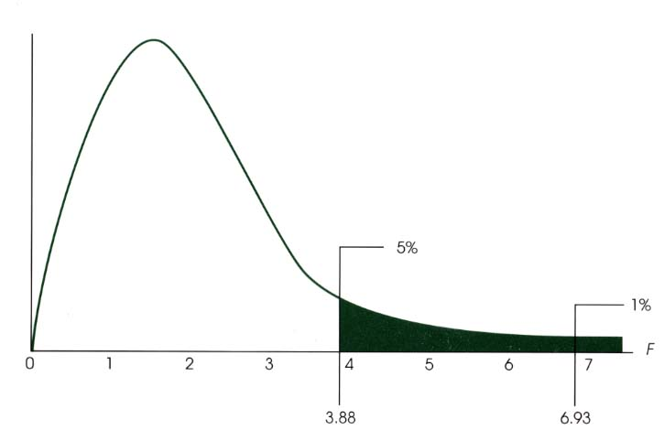
Distribution of F scores

Slide 18
F-table of critical values for ANOVA
Degrees of Freedom Denominator | Degrees of Freedom : Numerator
 | 1 | 2 | 3 | 4 | 5 | 6
10 | 4.96 10.04 | 4.10 7.56 | 3.71 6.55 | 3.48 5.99 | 3.33 5.64 | 3.22 5.39
11 | 4.84 9.65 | 3.98 7.20 | 3.59 6.22 | 3.36 5.67 | 3.20 5.32 | 3.09 5.07
12 | 4.75 9.33 | 3.88 6.93 | 3.49 5.95 | 3.26 5.41 | 3.11 5.06 | 3.00 4.82
13 | 4.67 9.07 | 3.80 6.70 | 3.41 5.74 | 3.18 5.20 | 3.02 4.86 | 2.92 4.62
14 | 4.60 8.86 | 3.74 6.51 | 3.34 5.56 | 3.11 5.03 | 4.96 4.69 | 2.85 4.46

Slide 19
Highlighted F-table of critical values for ANOVA
Degrees of Freedom Denominator | Degrees of Freedom : Numerator
 | 1 | 2 | 3 | 4 | 5 | 6
10 | 4.96 10.04 | 4.10 7.56 | 3.71 6.55 | 3.48 5.99 | 3.33 5.64 | 3.22 5.39
11 | 4.84 9.65 | 3.98 7.20 | 3.59 6.22 | 3.36 5.67 | 3.20 5.32 | 3.09 5.07
12 | 4.75 9.33 | 3.88 6.93 | 3.49 5.95 | 3.26 5.41 | 3.11 5.06 | 3.00 4.82
13 | 4.67 9.07 | 3.80 6.70 | 3.41 5.74 | 3.18 5.20 | 3.02 4.86 | 2.92 4.62
14 | 4.60 8.86 | 3.74 6.51 | 3.34 5.56 | 3.11 5.03 | 4.96 4.69 | 2.85 4.46

Slide 20
Pain Tolerance Study Data
Placebo | Drug A | Drug B | Drug C
0 | 0 | 3 | 8 | N = 12
0 | 1 | 4 | 5 | G = 36
3 | 2 | 5 | 5 | Σx² = 178
T = 3 | T = 3 | T = 12 | T = 18
SS = 6 | SS = 2 | SS = 2 | SS = 6

Slide 21
Pain Tolerance Study Data
Placebo | Drug A | Drug B | Drug C
0 | 0 | 3 | 8 | N = 12 | G² /N = 108
0 | 1 | 4 | 5 | G = 36
3 | 2 | 5 | 5 | Σx² = 178
T = 3 | T = 3 | T = 12 | T = 18
SS = 6 | SS = 2 | SS = 2 | SS = 6
n₁ = 3 | n₂ = 3 | n₃ = 3 | n₄ = 3

Slide 22
Pain Tolerance Study SS’s (1)
Placebo:
Drug A :

Slide 23
Pain Tolerance Study SS’s (2)
Drug B :
Drug C :

Slide 24
F calculation for pain tolerance study
Source | SS | df | MS | F | p < .05
Between Treatments | 54 | 3 | 18 | F(3,8) = 9.00 | ✓
Within Treatments | 16 | 8 | 2
Total | 70 | 11

Slide 25
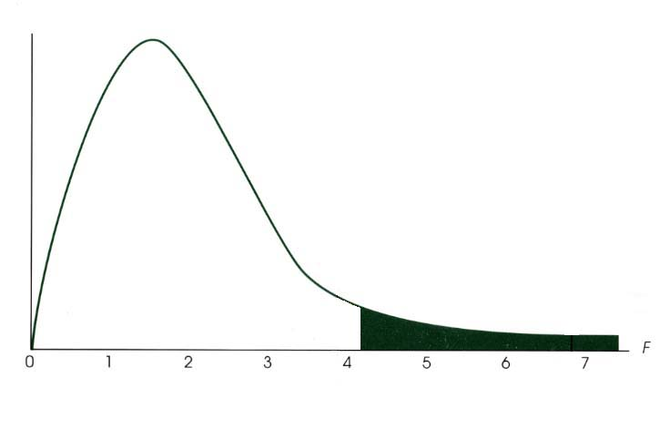
Distribution of critical F values for Pain tolerance study
5%
4.07

Slide 26
Reporting the results for the Pain Tolerance Study
The average length of time participants were able to tolerate a painful stimulus for each of the different drug conditions are presented in Table 1. A single-factor analysis of variance confirmed an overall effect of drug type on pain tolerance, F(3,8) = 9.00, MSE = 2.00, p < .05.

Slide 27
Table 1. Average time (seconds) a painful stimulus was endured for different drug treatment conditions.
 |  | Treatment Condition
 | Placebo |  | Drug A | Drug B | Drug C
M | 1.0 |  | 1.0 | 4.0 | 6.0
SD | 1.73 |  | 1.00 | 1.00 | 1.73

Slide 28
Average tolerance of a painful stimulus as a function of drug treatment condition
8
6
Time (seconds)
4
2
Placebo
Drug A
Drug B
Drug C
Treatment

Slide 29
Post Hoc Tests
After ANOVA when:
You reject H_{o} and…
There are 3 or more treatments (k > 3)

Slide 30
Tukey’s Honestly Significant Difference Test (or HSD)
Denominator of
F-ratio
From Table
(# of treatments, df_{within})
Number of Scores
in Each Treatment

Slide 31
Scheffe Test
Conservative - safest of all post hoc tests
Compute a new F-ratio for differences between any pair of means
MS_{between} (just for the pair of means tested)
F =
MS_{within} (from the overall ANOVA)
Use k from overall to compute df_{between}, therefore
df_{between} = k - 1
b) Critical F same as for the overall test

Slide 32
Drug Study Table of Means
Placebo | Drug A | Drug B | Drug C
n = 3 | n = 3 | n = 3 | n = 3
T = 3 | T = 3 | T = 12 | T = 18

Slide 33
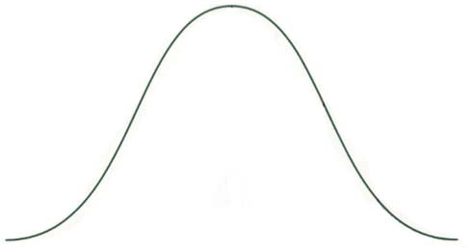
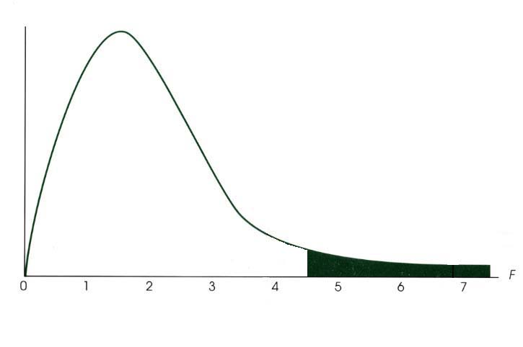
Comparison of T distribution and F distribution
95%
-2.101
0
2.101
95%
4.41
(2.101²)

Slide 34
Assumptions for Independent Measures ANOVA
Observations in each sample are independent.
Populations from which samples are selected must be normal.
Populations from which samples selected must have equal variances (homogeneity of variance)

Slide 35
Testing Homogeneity of Variance: Hartley’s F-max test
For independent measures designs
Compute sample variances for each sample:
3.
Compare the F-max obtained with the critical value in Table B3
k = number of samples
df = n-1 for each sample variance (equal sample sizes)
α level

Slide 36
The performance of different species of monkeys on a delayed response task.
Vervet | Rhesus | Baboon
n = 4 | n = 10 | n = 6 | N = 20
X = 9 | X = 14 | X = 4 | G = 200
T = 36 | T = 140 | T = 24 | Σx² = 3400
SS = 200 | SS = 500 | SS = 320

Slide 37
Comparison of Between versus Within Treatment
(a)
Between Treatments
Treatment I
Treatment II
16
18
20
22
24
26
28
30
32
34
36
38
40
42
44
46
Within Treatments
(b)
Between Treatments
Treatment I
Treatment II
16
18
20
22
24
26
28
30
32
34
36
38
40
42
44
46
Within Treatments

