Slide 1
Analysis of Variance Review
Review Sheet for Exam 3 on Psy 216 Website

Slide 2
I’ve created these Powerpoint Slides to help you prepare for the Exam.
The first group of slides lets you test yourself on identifying ANOVA designs: read the problem description and answer the question: “What is the design?”
Identify which type of ANOVA you think it is: Independent measures or Repeated Measures Design.
Click on the slide and the answer appears.
Go on to the next slide.
The second group of slides are for practicing filling out ANOVA source tables. Some of the tables are Independent Measures ANOVA source tables and some are Repeated Measures source tables.
Let me know if either of these exercises help you prepare.

Slide 3
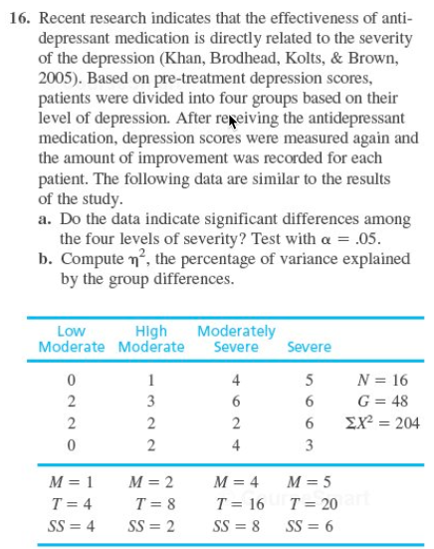
What is the design?
Independent Measures

Slide 4
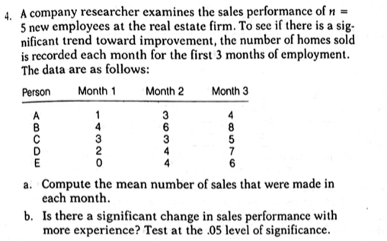
What is the design?
Repeated Measures

Slide 5
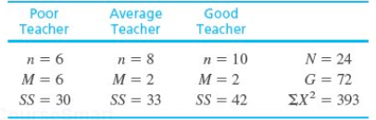
19. There is some evidence that high school students justify cheating in class on the basis of poor teacher skills or low levels of teacher caring (Murdock, Miller, and Kohlhardt, 2004). Students appear to rationalize their illicit behavior based on perceptions of how their teachers view cheating. Poor teachers are thought not to know or care whether students cheat, so cheating in their classes is okay. Good teachers, on the other hand, do care and are alert to cheating, so students tend not to cheat in their classes. Following are hypothetical data similar to the actual research results. The scores represent judgments of the acceptability of cheating for the students in each sample. Use an ANOVA with = .05 to determine whether there are significant differences in student judgments depending on how they see their teachers.
What is the design?
Independent Measures

Slide 6
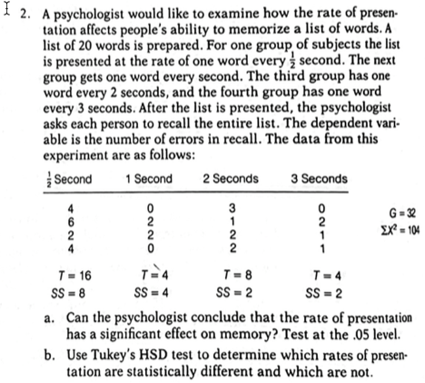
What is the design?
Independent Measures

Slide 7
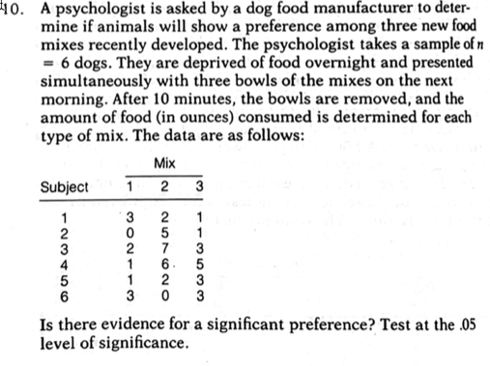
What is the design?
Repeated Measures

Slide 8
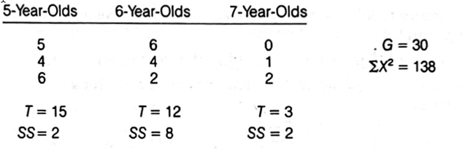
8. A developmental psychologist is examining problem-solving ability for grade school children. Random samples of 5-year- old, 6-year-old, and 7-year-old children are obtained with n = 3 in each sample. Each child is given a standardized problem-solving task, and the psychologist records the number of errors. These data are as follows:
What is the design?
Independent Measures

Slide 9
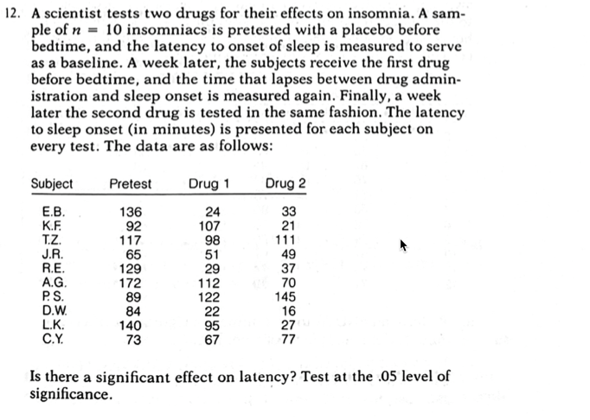
What is the design?
Repeated Measures

Slide 10
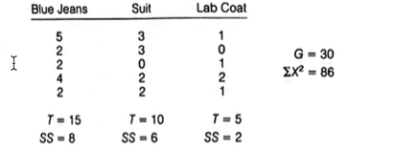
A social psychologist would like to examine the relationship between personal appearance and authority. A special questionnaire is prepared which requires very careful attention to instructions in order to fill it in correctly. Three random samples of college students are obtained. For the first group the psychologist dresses very casually (blue jeans and T-shirt) when the questionnaire is administered. For the second sam-ple, the psychologist wears a suit, and for the third sample the psychologist wears a very"scientific" laboratory coat. The psychologist records the number of errors made by each individual while completing the questionnaire. These data are as follows:
Should the psychologist conclude that appearance had an influence on the amount of attention people paid to the instructions? Test at the .05 level of significance.
What is the design?
Independent Measures

Slide 11
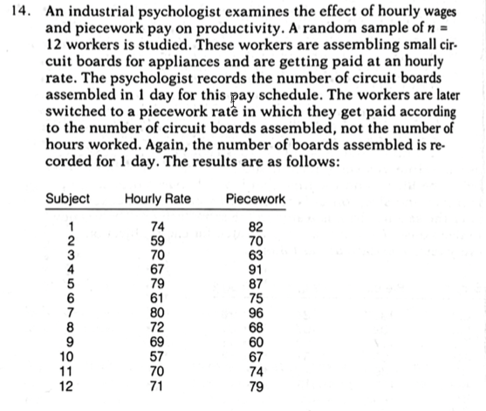
What is the design?
Repeated Measures

Slide 12
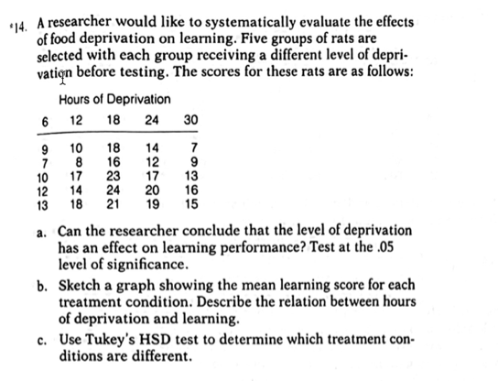
What is the design?
Independent Measures

Slide 13
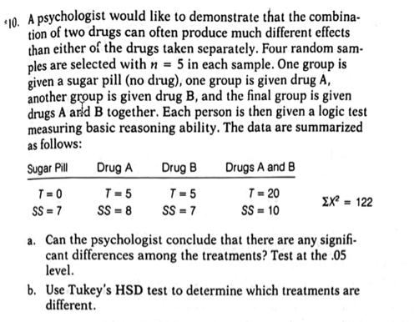
What is the design?
Independent Measures

Slide 14
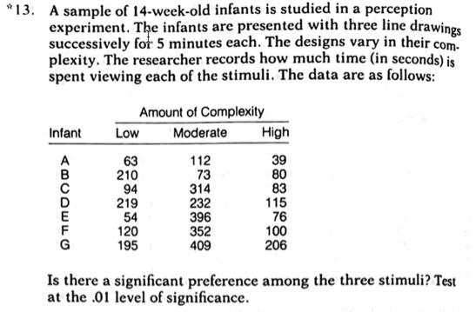
What is the design?
Repeated Measures

Slide 15
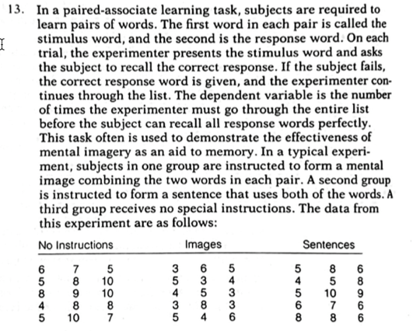
What is the design?
Independent Measures

Slide 16
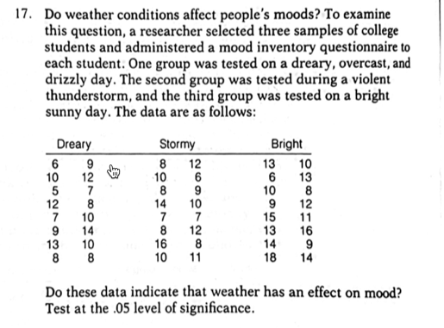
What is the design?
Independent Measures

Slide 17
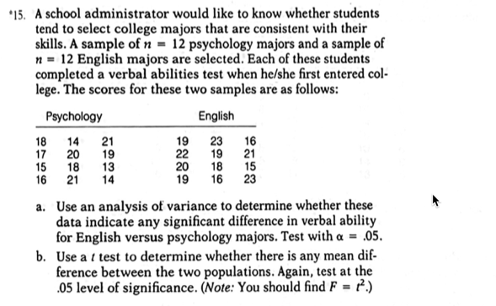
What is the design?
Independent Measures

Slide 18
The following slides are for practicing filling out ANOVA source tables. Some of the source tables are Independent Measures ANOVA source tables and some are Repeated Measures source tables. Try to fill the table out yourself and then go to the next slide, which has the source table completely filled out. However, before you look up the answers:
First translate everything you can from the written problem description into numbers. For example, if the problem tells you the number of treatments is 4, write down “k = 4”. Do the same for every number mentioned in the problem description.
Second, try to diagram the study. In other words, draw the data table that we set up before we do an ANOVA. This will help you see how many subjects there are and how many scores overall.
Figure out and fill out the degrees of freedom (the df’s) for the whole source table.
Now, work backwards or forwards from what you know in the source table to what you don’t know. For example, if you know the MS_{between} is 40 and the df_{between} are 2 then the SS_{between} must be 80, because SS_{between}/df_{between} is equal to Ms_{between}, and so on.

Slide 19
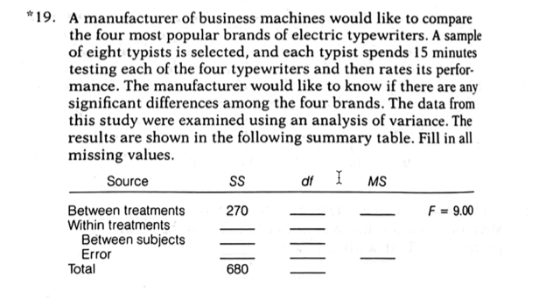

Slide 20
3
90
416
28
(206)
(7)
(210)
(21)
10
31

Slide 21
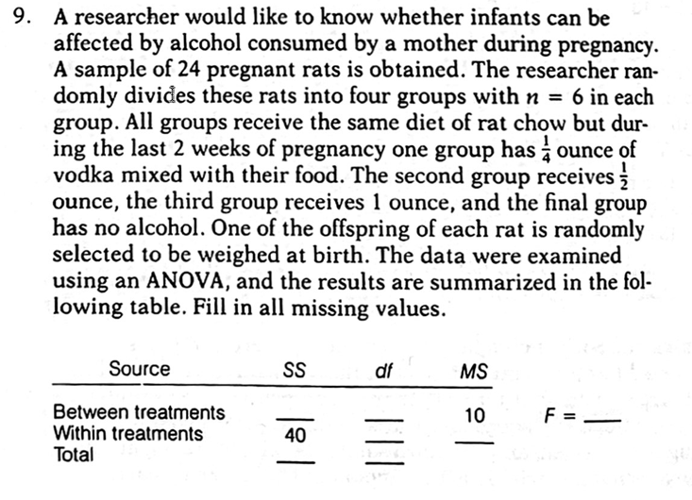

Slide 22
30
3
5.00
20
2
70
23

Slide 23
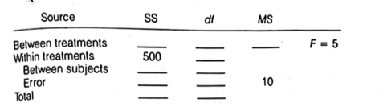
To determine the long-term effectiveness of relaxation training on anxiety, a researcher uses a repeated measures study. A random sample of n =10 subjects is first tested for the severity of anxiety with a standardized test. In addition to this pretest, subjects are tested again 1 week, 1 month, 6 months, and 1 year after treatment. The investigator used ANOVA to evaluate these data, and portions of the results are presented in the following summary table. Fill in the missing values. (Hint: Start with the df values.)

Slide 24
To determine the long-term effectiveness of relaxation training on anxiety, a researcher uses a repeated measures study. A random sample of n =10 subjects is first tested for the severity of anxiety with a standardized test. In addition to this pretest, subjects are tested again 1 week, 1 month, 6 months, and 1 year after treatment. The investigator used ANOVA to evaluate these data, and portions of the results are presented in the following summary table. Fill in the missing values. (Hint: Start with the df values.)
200
4
50
45
(999)
(9)
(140)
(36)
700
49

Slide 25
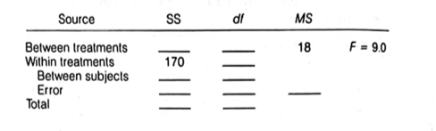
5. A teacher studies the effectiveness of a reading skills course on comprehension. A sample of n = 20 students is studied. The instructor assesses their comprehension with a standardized reading test. The test is administered at the beginning of the course, at midterm, and at the end of the course. The instructor uses analysis of variance to determine whether or not a significant change has occurred in the students' reading performance. The following summary table presents a portion of the ANOVA results. Provide the missing values in the table. (Start, with df values.)
2.0

Slide 26

5. A teacher studies the effectiveness of a reading skills course on comprehension. A sample of n = 20 students is studied. The instructor assesses their comprehension with a standardized reading test. The test is administered at the beginning of the course, at midterm, and at the end of the course. The instructor uses analysis of variance to determine whether or not a significant change has occurred in the students' reading performance. The following summary table presents a portion of the ANOVA results. Provide the missing values in the table. (Start, with df values.)
36
2
57
(94)
(19)
(76)
(38)
2.0
206
59

Slide 27
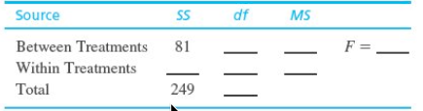
22. A developmental psychologist is examining the development of language skills from age to age 5. Four different groups of children are obtained, one for each age, with n = 15 children in each group. Each is child is given a language skills assessment test. The resulting data were analyzed with an ANOVA to test for mean differences between age groups. The results of the ANOVA are presented in the following table. Fill in all missing values.

Slide 28
22. A developmental psychologist is examining the development of language skills from age to age 5. Four different groups of children are obtained, one for each age, with n = 15 children in each group. Each is child is given a language skills assessment test. The resulting data were analyzed with an ANOVA to test for mean differences between age groups. The results of the ANOVA are presented in the following table. Fill in all missing values.
3
27
22.31
68
56
1.21
59

