Slide 1
Chapter 15: Correlation

Slide 2
So far…
We’ve focused on hypothesis testing
Is the relationship we observe between x and y in our sample true generally (i.e. for the population from which the sample came)
Which answers the following question: Is there a relationship between x and y? (Yes or No)
Where x is a categorical predictor and y is a continuous predictor

Slide 3
A new question…
If there is a relationship between x and y…
How strong is that relationship?
How well can we predict a person’s y score if we know x?
What is the strength of the relationship or the correlation between x and y

Slide 4
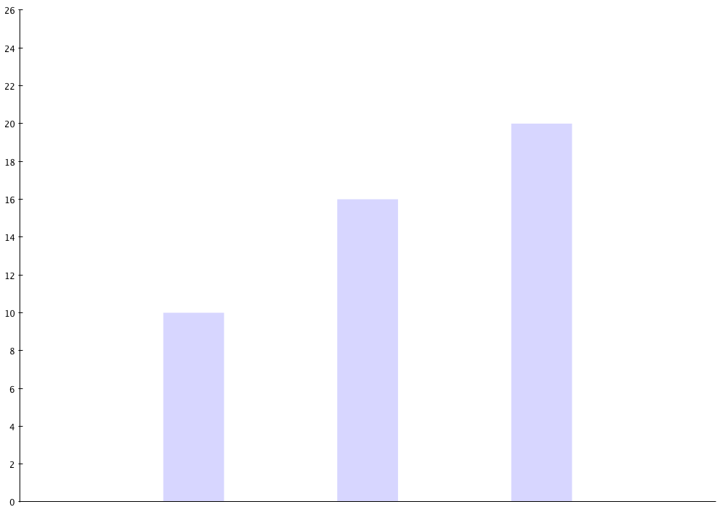
Mean Recall
Rote Rehearsal
Sentence
Interactive Imagery
Memory Strategy

Slide 5
•
•
•
•
•
•
•
•
•
Mean Recall
•
•
•
•
•
•
•
•
•
•
•
•
•
•
•
Rote Rehearsal
Sentence
Interactive Imagery
Memory Strategy

Slide 6
•
•
•
•
•
•
•
Mean Recall
•
•
•
•
•
•
•
•
•
•
•
•
•
•
•
•
•
Rote Rehearsal
Sentence
Interactive Imagery
Memory Strategy

Slide 7
•
•
•
•
•
•
•
•
•
Mean Recall
•
•
•
•
•
•
•
•
•
•
•
•
•
•
•
Rote Rehearsal
Sentence
Interactive Imagery
Memory Strategy

Slide 8
Mean Recall
Rote Rehearsal
Sentence
Interactive Imagery
Memory Strategy

Slide 9
26
24
•
•
22
•
•
20
•
•
•
Mean Recall
18
•
•
•
•
16
•
•
•
14
•
•
•
12
•
•
•
•
10
•
8
•
•
6
4
2
0
Rote Rehearsal
Sentence
Interactive Imagery
Memory Strategy

Slide 10
•
•
•
26
•
24
•
•
22
•
•
20
•
•
•
Mean Recall
18
•
16
•
•
14
•
12
•
10
•
•
8
•
•
6
•
4
•
•
2
•
0
Rote Rehearsal
Sentence
Interactive Imagery
Memory Strategy

Slide 11
However…
What if x is not a categorical variable
What if x is a continuous predictor…e.g. arousal level
And y is a continuous variable as well… e.g. performance level

Slide 12
26
24
22
20
Mean Performance Level
18
16
14
12
10
8
6
4
2
0
Low
Medium
High
Arousal Level

Slide 13
26
24
•
•
22
•
•
20
•
•
Mean Performance Level
•
18
•
•
•
•
16
•
•
•
14
•
•
•
12
•
•
•
•
10
•
8
•
•
6
4
2
0
Low
Medium
High
Arousal Level

Slide 14
26
24
•
•
22
•
•
•
•
20
•
•
Mean Performance Level
•
•
18
•
•
•
•
•
•
•
16
•
•
•
•
•
•
14
•
•
•
•
•
•
•
12
•
•
•
•
•
•
•
•
•
10
•
•
•
•
•
8
•
•
•
6
•
4
2
0
Low
Medium
High
Arousal Level

Slide 15
26
24
•
•
22
•
•
•
•
20
•
•
Mean Performance Level
•
•
18
•
•
•
•
•
•
•
16
•
•
•
•
•
•
14
•
•
•
•
•
•
•
12
•
•
•
•
•
•
•
•
•
10
•
•
•
•
•
8
•
•
•
6
•
4
2
0
Low
Medium
High
Arousal Level

Slide 16
26
24
•
•
•
22
•
•
•
•
•
•
•
•
•
20
•
•
•
•
•
Mean Performance Level
•
•
18
•
•
•
•
•
•
•
•
•
•
16
•
•
•
•
•
•
•
•
•
•
•
•
•
•
14
•
•
•
•
•
•
•
•
•
•
•
12
•
•
•
•
•
•
•
•
•
•
•
•
•
10
•
•
•
•
•
•
•
•
•
8
•
•
•
•
•
6
•
•
4
•
2
0
Low
Medium
High
Arousal Level

Slide 17
26
24
•
•
•
22
•
•
•
•
•
•
•
•
•
20
•
•
•
•
•
Mean Performance Level
•
•
18
•
•
•
•
•
•
•
•
•
•
16
•
•
•
•
•
•
•
•
•
•
•
•
•
•
14
•
•
•
•
•
•
•
•
•
•
•
12
•
•
•
•
•
•
•
•
•
•
•
•
•
10
•
•
•
•
•
•
•
•
•
8
•
•
•
•
•
6
•
•
4
•
2
0
0
2
4
6
10
12
14
16
18
Arousal Level

Slide 18
26
24
•
•
•
22
•
•
•
•
•
•
•
•
•
20
•
•
•
•
•
Mean Performance Level
•
•
18
•
•
•
•
•
•
•
•
•
•
16
•
•
•
•
•
•
•
•
•
•
•
•
•
•
14
•
•
•
•
•
•
•
•
•
•
•
12
•
•
•
•
•
•
•
•
•
•
•
•
•
10
•
•
•
•
•
•
•
•
•
8
•
•
•
•
•
6
•
•
4
•
2
0
0
2
4
6
10
12
14
16
18
Arousal Level

Slide 19
26
24
•
•
•
22
•
•
•
•
•
•
•
•
•
20
•
•
•
•
•
Mean Performance Level
•
•
18
•
•
•
•
•
•
•
•
•
•
16
•
•
•
•
•
•
•
•
•
•
•
•
•
•
14
•
•
•
•
•
•
•
•
•
•
•
12
•
•
•
•
•
•
•
•
•
•
•
•
•
10
•
•
•
•
•
•
•
•
•
8
•
•
•
•
•
6
•
•
4
•
2
0
0
2
4
6
10
12
14
16
18
Arousal Level

Slide 20
26
24
•
•
•
22
•
•
•
•
•
•
•
•
•
20
•
•
•
•
•
Mean Performance Level
•
•
18
•
•
•
•
•
•
•
•
•
•
16
•
•
•
•
•
•
•
•
•
•
•
•
•
•
14
•
•
•
•
•
•
•
•
•
•
•
12
•
•
•
•
•
•
•
•
•
•
•
•
•
10
•
•
•
•
•
•
•
•
•
8
•
•
•
•
•
6
•
•
4
•
2
0
0
2
4
6
10
12
14
16
18
Arousal Level

Slide 21
The relationship between exam grade and time needed to complete the exam
100
90
80
70
Grade (percent correct)
60
50
40
20
30
40
50
60
70
Time to complete exam (in minutes)

Slide 22
Plots of values as a function of x and y
Person | X | Y
A | 1 | 1
B | 1 | 3
C | 3 | 2
D | 4 | 5
E | 6 | 4
F | 7 | 5
5
D
F
4
E
3
B
Y values
2
C
1
A
1
2
3
4
5
6
7
8
X values

Slide 23
3 Characteristics of a Correlation:
Direction of relationship
Form of the relation
Degree of the relationship

Slide 24
Correlations: Measuring and Describing Relationships (cont.)
The direction of the relationship is measured by the sign of the correlation (+ or -). A positive correlation means that the two variables tend to change in the same direction; as one increases, the other also tends to increase. A negative correlation means that the two variables tend to change in opposite directions; as one increases, the other tends to decrease.

Slide 25
The relationship between coffee sales and temperature
60
50
40
Amount of beer sold
30
20
10
20
30
40
50
60
70
80
Temperature (in degrees F)

Slide 26
The relationship between beer sales and temperature
60
50
40
Amount of coffee sold
30
20
10
20
30
40
50
60
70
80
Temperature (in degrees F)

Slide 27
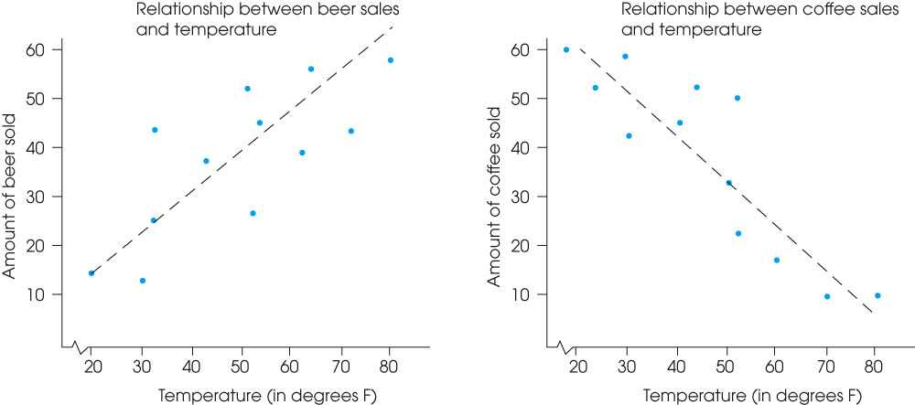
Notes:
Figure 16.3
Examples of positive and negative relationships. (a) Beer sales are positively related to temperature. (b) Coffee sales are negatively related to temperature.

Slide 28
Correlations: Measuring and Describing Relationships (cont.)
The most common form of relationship is a straight line or linear relationship which is measured by the Pearson correlation.

Slide 29
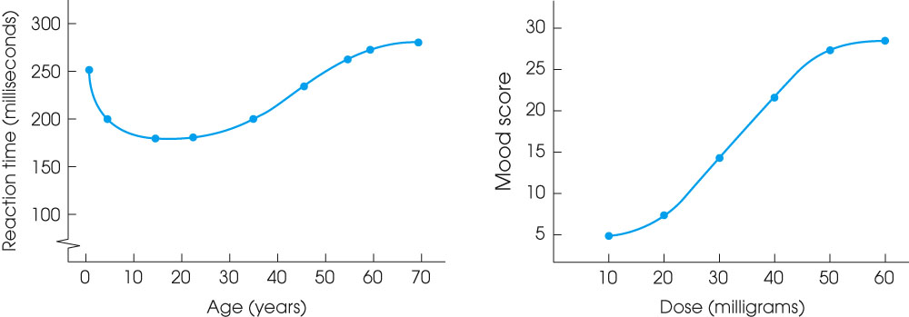
Notes:
Figure 16.4
Examples of relationships that are not linear: (a) relationship between reaction time and age; (b) relationship between mood and drug dose.

Slide 30
Comparison of performance based on amount of practice and male/female vocab scores
(a)
4
3
Performance
2
1
1
2
3
4
5
6
7
Amount of practice
(b)
Vocabulary score
Male
Female

Slide 31
Correlations: Measuring and Describing Relationships (cont.)
The degree of relationship (the strength or consistency of the relationship) is measured by the numerical value of the correlation. A value of 1.00 indicates a perfect relationship and a value of zero indicates no relationship.

Slide 32
Plot of points - wide dispersion
100
90
80
70
60
50
40
20
30
40
50
60
70

Slide 33
Plot of points - narrow dispersion
100
90
80
70
60
50
40
20
30
40
50
60
70

Slide 34
Examples of different values for linear correlations
Y
(a)
Y
(b)
X
X
Y
(c)
Y
(d)
X
X

Slide 35
Where and Why Correlations are Used:
Prediction
Validity
Reliability
Theory Verification

Slide 36
Correlations: Measuring and Describing Relationships (cont.)
To compute a correlation you need two scores, X and Y, for each individual in the sample.
The Pearson correlation requires that the scores be numerical values from an interval or ratio scale of measurement.
Other correlational methods exist for other scales of measurement.

Slide 37
The Pearson Correlation
The Pearson correlation measures the direction and degree of linear (straight line) relationship between two variables.
To compute the Pearson correlation, you first measure the variability of X and Y scores separately by computing SS for the scores of each variable (SS_{X} and SS_{Y}).
Then, the covariability (tendency for X and Y to vary together) is measured by the sum of products (SP).
The Pearson correlation is found by computing the ratio:

Slide 38
The Pearson Correlation (cont.)
Thus the Pearson correlation is comparing the amount of covariability (variation from the relationship between X and Y) to the amount X and Y vary separately.
The magnitude of the Pearson correlation ranges from 0 (indicating no linear relationship between X and Y) to 1.00 (indicating a perfect straight-line relationship between X and Y).
The correlation can be either positive or negative depending on the direction of the relationship.

Slide 39
The Pearson Correlation

Slide 40
The Pearson Correlation
PDF version

Slide 41
Computational Examples

Slide 42
Computing the SP
Scores
Deviations
Products
(
)
(
)
(
)
)
(
1 | 3
2 | 6
4 | 4
5 | 7

Slide 43
Computing the SP
Scores
Deviations
Products
(
)
(
)
(
)
)
(
1 | 3 |  | 2 |  | -2 |  | +4
2 | 6 |  | -1 |  | +1 |  | -1
4 | 4 |  | +1 |  | -1 |  | -1
5 | 7 |  | +2 |  | +2 |  | +4

Slide 44
Computing the SP with the Computational Formula
xy
1
2
4
5
3
6
4
7
3
12
16
35
= 12
= 20
= 66

Slide 45
X | Y
0 | 1
10 | 3
4 | 1
8 | 2
8 | 3

Slide 47
Computing a Pearson Correlation
Scores
1. First draw a scatterplot of the x and y data pairs.
1 | 3
2 | 6
4 | 4
5 | 7
2. Then compute the Pearson r correlation coefficient
3. Compare the scatterplot to the calculated Pearson r

Slide 48
Understanding & Interpreting the Pearson Correlation
Correlation is not causation
Correlation greatly affected by the range of scores represented in the data
One or two extreme data points (outliers) can dramatically affect the value of the correlation
How accurately one variable predicts the other—the strength of a relation

Slide 49
Correlation is not causation

Slide 50
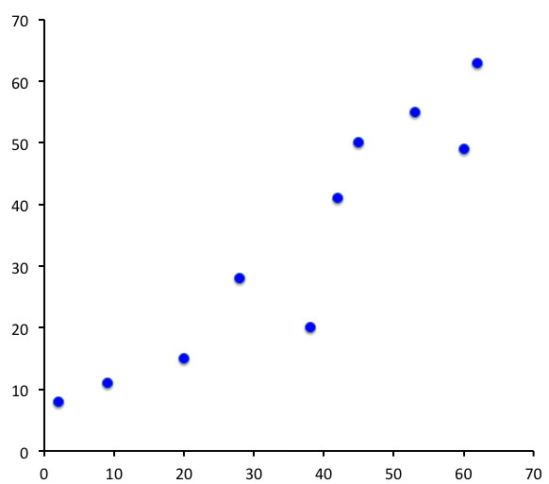
Scatterplot of Number of Serious Crimes and Number of Churches
Number of Serious Crimes
Number of Churches

Slide 51
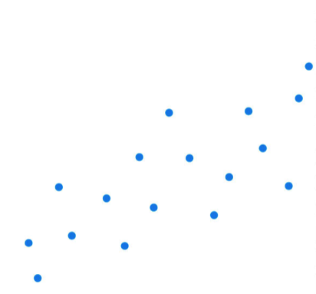
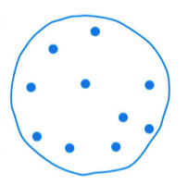
Y Values
When we look at the full range of X, the correlation changes.
X values restricted to a limited range
X Values

Slide 52
Restricted Range Problem
Y Values
X values restricted to a limited range
X Values

Slide 53
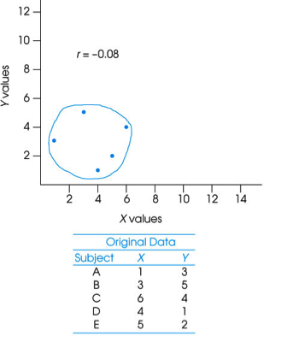
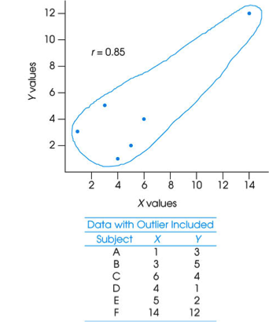
Outliers and Correlations

Slide 54
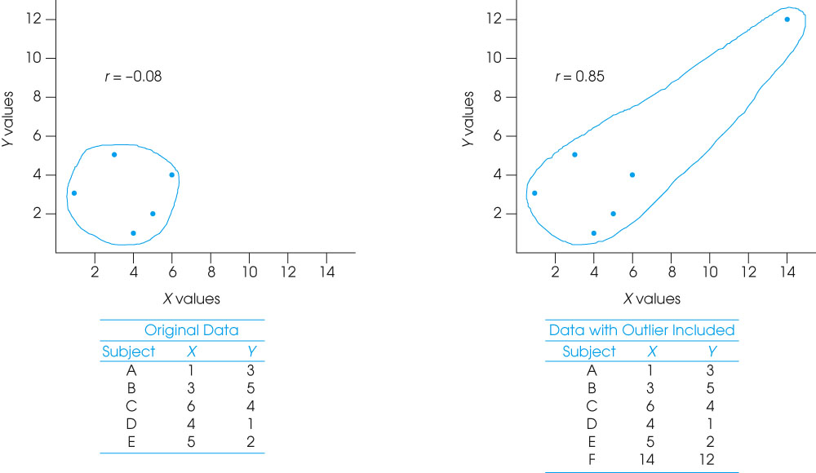
Fig. 16-9, p. 533
Notes:
Figure 16.9
A demonstration of how one extreme data point (an outlier) can influence the value of a correlation.

Slide 55
Coefficient of Determination (r²)
With r = 0, None of the Y variability can be predicted from X; r² = 0
X
Y
X
Y
X
Y
With r = 0.8, the Y variability is partially predicted from the relation with X; r² = 0.64 or 64%
With r = 1.0, the Y variability is completely predicted from the relation with X; r² = 1.00 or 100%

Slide 56
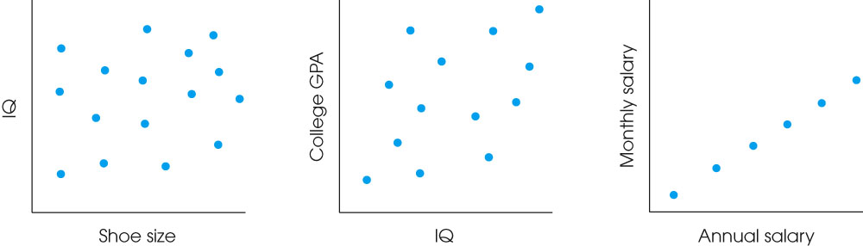
r versus r²
r = 0
r² = 0
r = .80
r² = .64 or 64%
r = 1.0
r² = 1.0 or 100%

Slide 57
Different Types of Correlation
Pearson Correlation – Used only when x and y are both interval or ratio scales
If either X or Y are not interval or ratio scales, then we compute a different correlation coefficient.

Slide 58
Other Types of Correlation
Spearman Correlation – Used when either x or y (or both) are ordinal scales
Point-Biserial: Used when one variable is interval or ratio and the other variable is dichotomous (two values – e.g. male/female)
Phi-Coefficient – Used when both variables (x and y) are dichotomous.

Slide 59
The Spearman Correlation
The Spearman correlation is used in two general situations:
(1) When X and Y are both consist of ranks (ordinal scales).
(2) When X and Y are interval/ratio BUT there are outliers in the data--both variables can be converted to ranks and a Spearman correlation is computed.

Slide 60
The Spearman Correlation (cont.)
The calculation of the Spearman correlation requires:
1. Two variables are observed for each individual.
2. The observations for each variable are rank ordered. The X values and Y values are ranked separately.
After the variables have been ranked, the Spearman correlation is computed by using the same formula used for the Pearson but substituting the ranked data.

Slide 61
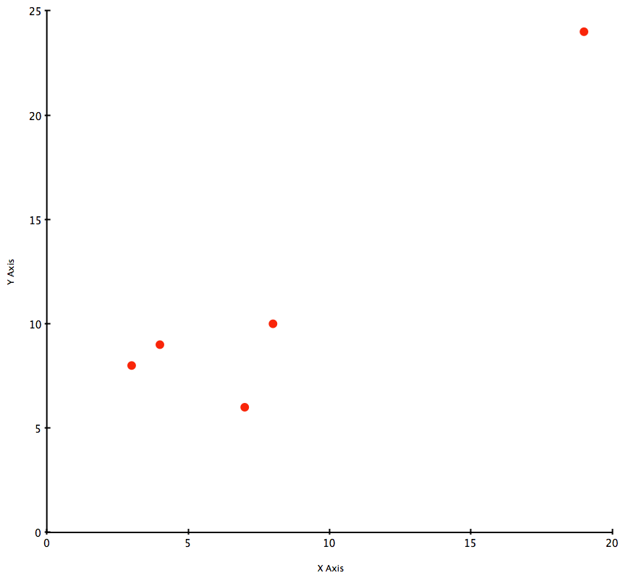
This outlier will change the correlation dramatically.
Subject | X | Y
A | 3 | 8
B | 7 | 6
C | 4 | 9
D | 8 | 10
E | 19 | 24

Slide 62
So we transform our scores into ranks…
Original Scores
Subject | X | Y
A | 3 | 8
B | 7 | 6
C | 4 | 9
D | 8 | 10
E | 19 | 24
Compute Correlation on the Ranks
Subject | X Rank | Y Rank
A | 1 | 2
B | 3 | 1
C | 2 | 3
D | 4 | 4
E | 5 | 5
Convert Original Scores to Ranks
Subject | X Rank | Y Rank
A | 3 (1st) | 8 (2nd)
B | 7 (3rd) | 6 (1st)
C | 4 (2nd) | 9 (3rd)
D | 8 (4th) | 10 (4th)
E | 19 (5th) | 24 (5th)

Slide 63
Ranking Tied Scores
List the scores from smallest to largest. Include tied values in the list.
Assign a rank (1st, 2nd, 3rd, etc.) to each score in the ordered list.
When two (or more) scores are tied, compute the mean of their ranks and assign this mean value as the rank for each of the tied scores.

Slide 64
For example…
Here are some scores with ties: 3, 5, 3, 6, 6, 12, 6
1. List the scores from low to high.
2. Assign a rank to each score
3. For each group of tied scores, compute a mean rank and assign it to each tied score in that group.
Scores
Rank
Final Rank
3
3
5
6
6
6
12
1
2
3
4
5
6
7
1.5
1.5
3
5
5
5
7

Slide 65
The Point-Biserial Correlation and the Phi Coefficient
The same correlation formula can also be used to measure the relationship between two variables when one or both of the variables is dichotomous.
A dichotomous variable is one for which there are exactly two categories: for example, men/women or succeed/fail.

Slide 66
The Point-Biserial Correlation and the Phi Coefficient (cont.)
In situations where one variable is dichotomous and the other consists of regular numerical scores (interval or ratio scale), the resulting correlation is called a point-biserial correlation.
When both variables are dichotomous, the resulting correlation is called a phi-coefficient.

Slide 67
Point-Biserial Correlation
Used in situations where one variable is measured on an interval or ratio scale but the second variable has only two different values (i.e. a dichotomous variable). Examples:
Vocabulary scores for Males versus Females
IQ scores for college grad versus non college grads
Memory scores for visual imagery group versus rote rehearsal group

Slide 68
Original Data
Converted Data
Attitude Score (Y)
Gender (X)
Attitude Score (Y)
Gender (X)
8
7
4
6
1
9
3
4
Male
Female
Male
Male
Female
Male
Female
Female
8
7
4
6
1
9
3
4
0
1
0
0
1
0
1
1

Slide 69
The Point-Biserial Correlation (cont.)
The point-biserial correlation is closely related to the independent-measures t test introduced in Chapter 10.
When the data consists of one dichotomous variable and one numerical variable, the dichotomous variable can also be used to separate the individuals into two groups.
Then, it is possible to compute a sample mean for the numerical scores in each group.

Slide 70
The Point-Biserial Correlation (cont.)
In this case, the independent-measures t test can be used to evaluate the mean difference between groups.
The t-statistic and the point-biserial correlation coefficient are mathematically related. One can be derived from the other.

Slide 71


t² and r² are related
Remember: df = n - 2

Slide 72
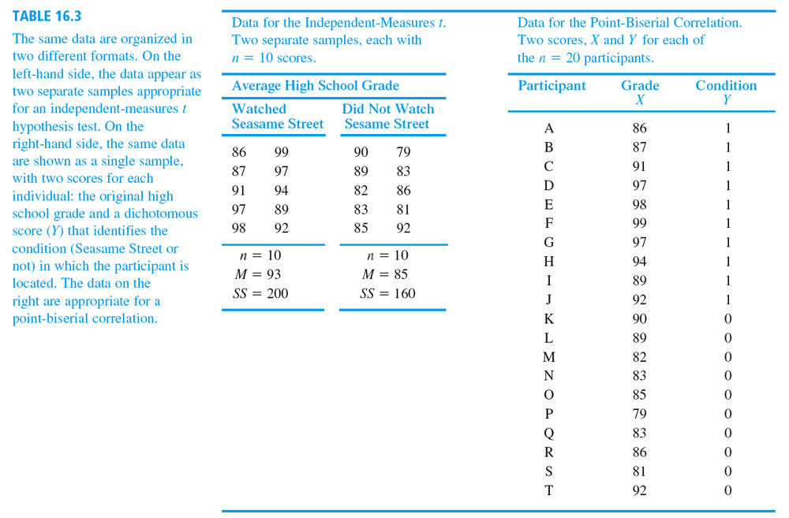

Slide 73
Phi Coefficient

Slide 74
Original Data
Converted Data
Birth Order (X)
Personality (Y)
Birth Order (X)
Personality (Y)
1st
3rd
Only
2nd
4th
2nd
Only
3rd
Introvert
Extrovert
Extrovert
Extrovert
Extrovert
Introvert
Introvert
Extrovert
0
1
0
1
1
1
0
1
0
1
1
1
1
0
0
1

