Slide 1
Chapter 6: Probability

Slide 2
Flow of inferential statistics and probability
Inferential Statistics
Sample
Population
Probability
Notes:
Remember that our goal is to use samples to answer questions about populations. In other words, we want to go from a sample result to a generalization about the makeup of a population. The means to do this is probability. First we link populations to samples by probability and see how knowing something about the population enables us to predict specific sample outcomes. Then we use probability to reverse the process: In other words given a specific sample outcome we can decide what the makeup of the population is from which the sample was selected. Let’s see how we can do this.

Slide 3
Jars of Marbles
Population 1
Population 2
50 black marbles
50 red marbles
90 black marbles
10 red marbles
P(black) = .50
P(black) = .90
Notes:
Suppose we have a population of marbles that has 50 black and 50 red marbles. A marble is selected at random. Consider this a sample of size n = 1. What is the likelihood that the marble picked is black? Although you can’t say definitively, you can state that the likelihood or probability is 50% or .50 (p = .50) Or the chances are 50-50.
Now consider a second jar ( population) of marbles that has 90 black marbles and 10 red marbles. Imagine selecting a marble at random from the second population. What is the probability of picking a black marble now? Much more likely (.90 or 90 Percent). Why? Because the proportion of black marbles in much higher in population two.
So, knowing the make-up of the population we can determine the probability of obtaining specific sample outcomes.
In this way, probability gives us a connection between populations and samples and this connection is the foundation for inferential statistics that are presented in the coming chapters.
Here we begin with a population and use probability to describe the samples that could be obtained. However, we can reverse this process and using samples to make inferences about populations (or possible populations) using sample data.

Slide 4
Jars of Marbles
Population 1
Population 2
50 black marbles
50 red marbles
90 black marbles
10 red marbles
Sample of n = 4 selected. All 4 marbles are black. Which population did it come from?
Notes:
So, now imagine that you’re blindfolded and a sample of size 4 (n =4) is selected. Your task is to look at the sample outcome and decide which jar (population) the sample came from. So, if you select a sample of size n =4 and all 4 marbles turn out to be black, which jar did the sample come from? What is the sample size was 6 or 7? Note. You are now using a sample to make an inference about a population.

Slide 5
Probability Equation
Probability of A
Number of outcomes classified as A
=
Total number of possible outcomes

Slide 6
Probability is Proportion
Coin tosses -- p (heads) = ?
Cards
p (King of Hearts) = ?
p (ace) = ?
p (red ace) = ?

Slide 7
Number list
6, 6, 7, 7, 7, 7, 8, 8, 8, 9

Slide 8
Simple frequency table
x | f
9 | 1
8 | 3
7 | 4
6 | 2
Notes:
We cant also talk about the probability of selecting a given score from a distribution of scores. For example, here we have 10 scores. What is the probability of randomly selecting a score of 8? Three out of 10 or .30.

Slide 9
Random Sample
Each individual in the population has an equal chance of being selected.
If more than one individual is selected, there must be constant probability for each and every selection.

Slide 10
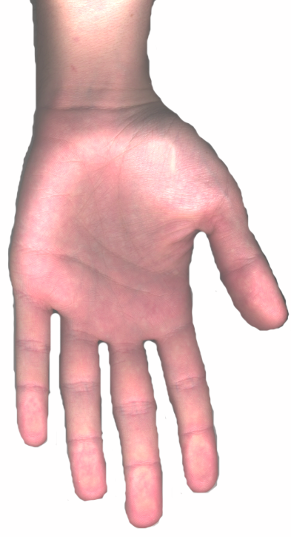
Biased Sample

Slide 11
What do we mean by a constant probability?
Imagine selecting two cards from a deck
First pick: P(Jack) = ?
Second pic: P(Jack) = ? (It depends)
Sampling with replacement (put the first card picked back in the deck)

Slide 12
Probabilities for a range of scores
In statistics we are often interested in computing probabilities for a range of scores from a distribution
For example what is the probability of a score greater than 4?
P(x > 4) = ?
P(x < 3) = ?

Slide 13
1, 1, 2, 3, 3, 4, 4, 4, 5, 6
x | f
6 | 1
5 | 1
4 | 3
3 | 2
2 | 1
1 | 2

Slide 14
What is the probability of a score greater than 4?
P(x > 4) = ?
3
2
frequency
1
X
1
2
3
4
5
6
7
8
P(x > 4) = .20

Slide 15
What is the probability of a score less than 3?
P(x < 3) = ?
3
2
frequency
1
X
1
2
3
4
5
6
7
8
P(x < 3) = .30

Slide 16
What is the probability of a score less than 3 or greater than 4?
P(x < 3 or x > 4) = ?
3
2
frequency
1
X
1
2
3
4
5
6
7
8
P(x < 3 or x > 4) = .50

Slide 17
So the proportion of area corresponding to a range of scores is the probability of selecting a score within that range

Slide 18
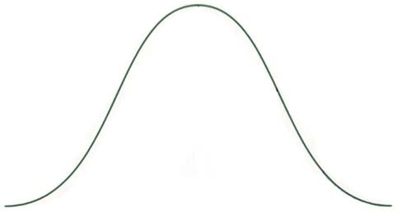
Normal Curve
σ
X
µ

Slide 19
Normal Curve with percentages
34.13%
13.59%
13.59%
2.28%
z
-2
-1
0
+1
+2
µ

Slide 20
Comparison of Curves
6.5 (a)
σ = 6
X
68
74
80
µ
(b)
z
68
74
80
µ
0
+2.00

Slide 21
Curve broken down into + - 3 sd’s
σ
z
-3
-2
-1
0
+1
+2
+3

Slide 22
Proportion in Tail vs. Body
(A) z | (B) Proportion in Body | (C) Proportion in Tail
0.00 | 0.5000 | 0.5000
0.01 | 0.5040 | 0.4960
0.02 | 0.5080 | 0.4920
0.03 | 0.5120 | 0.4880
0.21 | 0.5832 | 0.4168
0.22 | 0.5871 | 0.4129
0.23 | 0.5910 | 0.4090
0.24 | 0.5948 | 0.4052
0.25 | 0.5987 | 0.4013
0.26 | 0.6026 | 0.3974
0.27 | 0.6064 | 0.3936
0.28 | 0.6103 | 0.3897
0.29 | 0.6141 | 0.3859
B
Mean
z
C
C
Mean
z

Slide 23
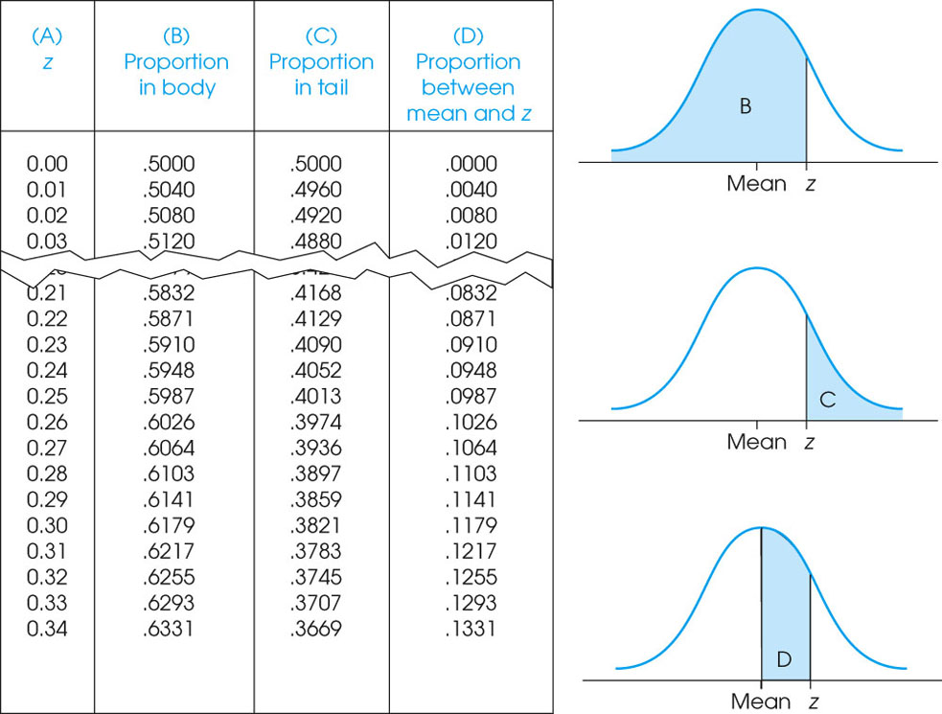
Notes:
Figure 6.6
A portion of the unit normal table. This table lists proportions of the normal distribution corresponding to each z-score value. Column A of the table lists z-scores. Column B lists the proportion in the body of the normal distribution up to the z-score value. Column C lists the proportion of the normal distribution that is located in the tail of the distribution beyond the z-score value. Column D lists the proportion between the mean and the z-score value.

Slide 24
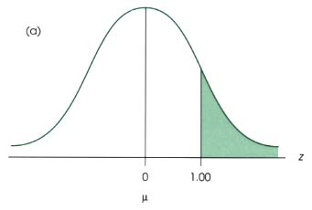
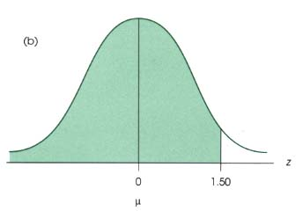
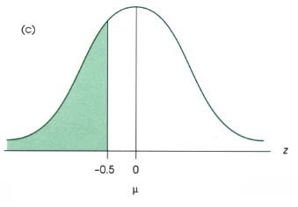
Comparison of 3 curves
(a)
(b)
z
z
0
1.0
0
1.5
µ
µ
(c)
z
-.5
0
µ

Slide 25
Comparison of 2 normal curves
(a)
z
-0.40
0
1.25
µ
(b)
z
0
0.35
1.40
µ

Slide 26
Z-score formula in relation to probability
z-score formula
X
Z
Unit
normal
table
Probability

Slide 27
Normal curve with mean, 1 sd, and 2 z-scores
If you select a score at random what is the probability of a score greater than 650?
σ = 100
?
X
500
650
µ
z
0
1.50

Slide 28
Normal curve with mean, 2 sd’s, and 3 z-scores
If you select a score at random what is the probability of a score between 600 and 700?
σ = 100
?
X
500
600
700
µ
z
0
1.00
2.00

Slide 29
Normal curve with top 15% shaded
Find the 85th percentile score for this distribution
Lower 85%
Top 15%
σ = 100
X
µ = 500
X = ?
z
0
1.04
?
z scale

Slide 30
Curve with mean of 100, shaded below 114
If you select a score at random what is the probability of a score less than 114?
σ = 10
X
µ = 100
114
z
0
1.40

Slide 31
Curve with mean of 100, shaded below 92
If you select a score at random what is the probability of a score less than 92?
σ = 10
?
X
92
µ = 100
z
-0.80
0

Slide 32
Curve with mean of 60, shaded below 34%
Find the 34th percentile score for this distribution
P = 0.3400
or 34%
σ = 5
X
x = ?
µ = 60

Slide 33
Normal Curve with Quartiles
25%
25%
25%
25%
z
-0.67
0
+0.67
Q1
Q2
Q3
Quartiles

Slide 34
Probability of heads in two coin tosses
0.50
Probability
0.25
0
0
1
2
Number of heads
in two coin tosses

Slide 35
Probability of heads in 4 & 6 coin tosses
(a)
0.375
Probability
0.250
0.125
0
1
2
3
4
Number of Heads in four coin tosses
(b)
0.2500
0.1875
Probability
0.1250
0. 0625
0
1
2
3
4
5
6
Number of Heads in six coin tosses

Slide 36
The Relationship Between the Binomial Distribution and the Normal Distribution
X
0
1
2
3
4
5
6
7
8
9
10

