Slide 1
Chapter 9: Introduction to the t statistic

Slide 2
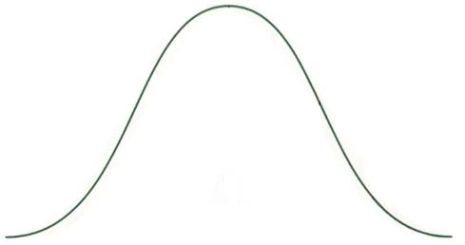
Population comparison before and after treatment
Known population
before treatment
Unknown population
after treatment
Treatment
µ = 30
µ = ?

Slide 3
z and t formulas

Slide 4
State the hypotheses:
  e.g. H_{o} : µ = 25
  H₁ : µ ≠ 25
  α = .01
Set the criteria for decision
Collect sample data and compute sample statistic
Decision (retain / reject H_{o})
Conclusion

Slide 5
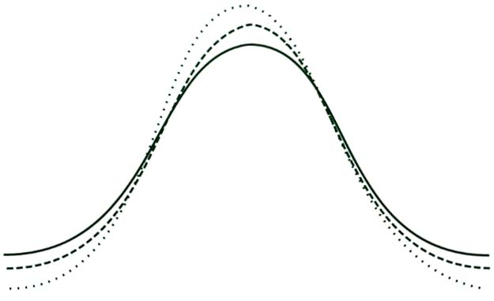
Comparison of a normal distribution to 2 t-distributions
Normal distribution
t distribution, df = 20
t distribution, df = 5
0

Slide 6
Proportion table
Proportion in One Tail
 | 0.25 | 0.10 | 0.05 | 0.025 | 0.01 | 0.005
Proportion in Two Tails
df | 0.50 | 0.20 | 0.10 | 0.05 | 0.02 | 0.01
1 | 1.000 | 3.078 | 6.314 | 12.706 | 31.821 | 63.657
2 | 0.816 | 1.886 | 2.920 | 4.303 | 6.965 | 9.925
3 | 0.765 | 1.638 | 2.353 | 3.182 | 4.541 | 5.841
4 | 0.741 | 1.533 | 2.132 | 2.776 | 3.747 | 4.604
5 | 0.727 | 1.476 | 2.015 | 2.571 | 3.365 | 4.032
6 | 0.718 | 1.440 | 1.943 | 2.447 | 3.143 | 3.707

Slide 7
Distribution segmented by top 5% and bottom 5%
5%
5%
t
-2.353
0
2.353

Slide 8
Distribution segmented by top 2.5% and bottom 2.5%
2.5%
2.5%
t
-3.182
0
3.182

Slide 9
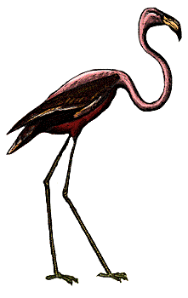

Bird problem?

Slide 10
Two-tailed Distribution with 15 degrees of freedom
df = 15
Reject H_{o}
Reject H_{o}
Fail to reject H_{o}
t
-2.131
2.131

Slide 11
One tailed Distribution with 15 degrees of freedom
df = 15
Reject H_{o}
Fail to reject H_{o}
t
1.753

Slide 12
Assumptions of t test
Values in sample must consist of independent observations
Population sampled must be normal

Slide 13
Advantages of t statistic
You do not need to know the σ (standard deviation) of the population
Use in situations where we do not have a “known” population to serve as a before treatment standard
H_{o} can come from theory, prediction, or whatever

Slide 14
What is the effect of RH Cerebral Brain Damage?
On a standardized spatial skills test, normative data reveal that people typically get μ = 15 correct solutions. A psychologist selected a sample of n = 7 individuals with right cerebral hemisphere damage to test whether their performance on the spatial skills test is significantly impaired.
Unfortunately he has no information about the standard deviation for the spatial skills test.

Slide 15
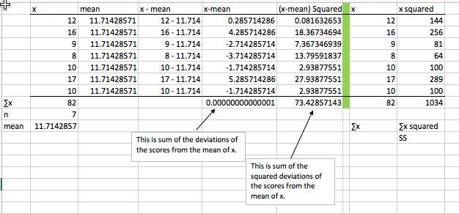
Calculating the Sum of the Squared Deviations (SS)

